Slide 1


AI Tutor: Enhancing In-Car User Experience
Explore how AI-powered navigation systems revolutionize in-car experiences by providing real-time traffic updates, personalized route suggestions, and predictive maintenance alerts, enhancing safety and convenience for drivers.
Hackathon: TATA INNOVENT.
Team: AI Wizards.
Team Members:
Ashish Ranjan Pathak Reg.no:2241016235
Anushka Patnaik Reg.no:2241016244
Bhumika Samal Reg.no:2241019251 .

Slide 2

Introduction
Problem: Generative AI-based interactive tools for product information and troubleshooting.
Objective: Create an AI that listens to and answers voice commands to help users learn about cars and provide faster solutions to in-car problems.

Slide 3


Tools and Technologies
Python: Main programming language used for the AI tutor's core functionality.
OpenAI API: Utilizes the latest language models like GPT-3.5 for natural language processing and response generation.
Speech Recognition: Converts user voice commands into text for processing.
pyttsx3: Enables text-to-speech conversion for the AI Tutor's audio responses.
Web browser: Allows the AI Tutor to open and interact with web pages on the user's behalf.
OS Module: Provides access to the operating system for tasks like file management and system commands

Slide 4

Key Features of A.I.
Voice Commands
Users can seamlessly interact with the AI Tutor by issuing natural voice commands, enabling a more intuitive and hands-free experience.
Web Integration
The AI Tutor provides effortless access to a wealth of information from popular websites like YouTube, Wikipedia, and Google, empowering users to find answers and explore topics with ease.
Time Check
With the AI Tutor, users can conveniently check the current time, enabling more efficient scheduling and better coordination in their daily activities.
Error Handling
The AI Tutor intelligently manages API limitations and other potential issues, ensuring a seamless and reliable user experience, even in the face of unexpected challenges.

Slide 5

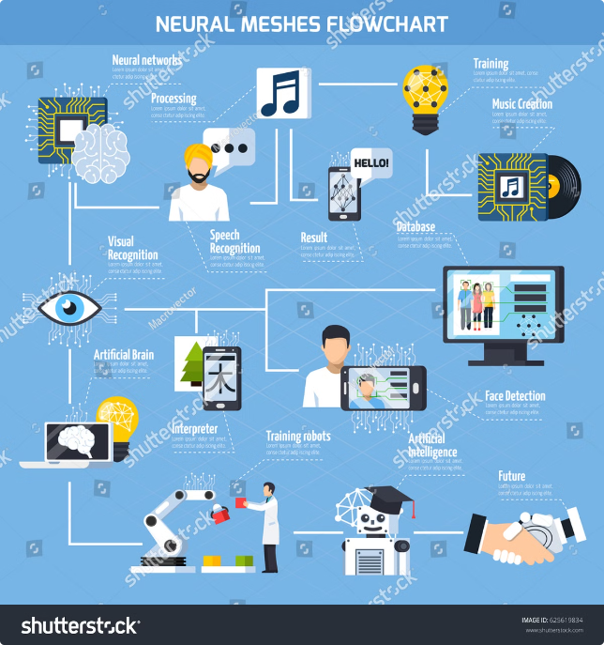
How It Works
1
Voice Input
Uses Speech Recognition to capture voice commands.
2
Processing
The command is processed and matched to pre-defined functions.
3
Response Generation
OpenAI's advanced language models generates a response.
4
Python
The generated response is converted to speech using the pyttsx3 text-to-speech engine.

Slide 6
Challenges in Current In-Car Experiences
Limited Functionality
Information Overload
Lack of Personalisation
Current in-car systems often lack the intuitive and adaptable features necessary for an engaging and user-friendly experience.
Drivers are bombarded with too much data, leading to distractions and difficulty in accessing critical information.
Many systems fail to tailor their responses to individual needs, resulting in a generic and impersonal user experience.

Slide 7


1
Natural Language Processing
The AI tutor understands natural language commands and responses, allowing for intuitive interactions with the system
2
Machine Learning
The AI tutor learns from driver behavior and preferences, providing personalized recommendations and assistance
3
Contextual Awareness
The AI tutor takes into account various factors, such as location, time of day, and traffic conditions, to provide relevant information.
4
Data Analytics
The AI tutor analyzes driving data to identify patterns and provide insights for improving driving efficiency and safety.

Slide 8
Personalized Learning and Adaptive Interfaces
Driver Profile Creation
Adaptive Interface
Personalized Feedback
The AI tutor collects initial data about the driver, including driving preferences, commute patterns, and desired learning goals.
The AI tutor continuously monitors driving behavior and adjusts its recommendations and assistance based on individual progress and feedback.
The AI tutor provides tailored feedback and insights based on driving patterns, highlighting areas for improvement and recognizing strengths.

Slide 9

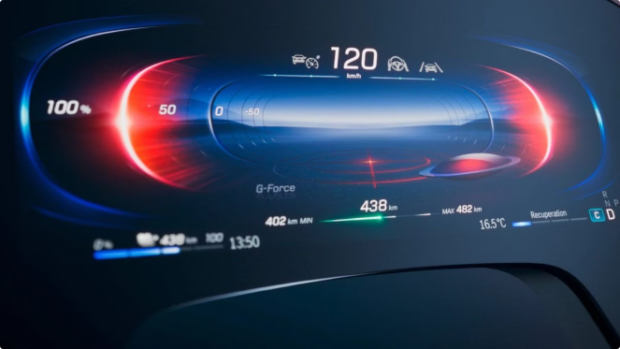


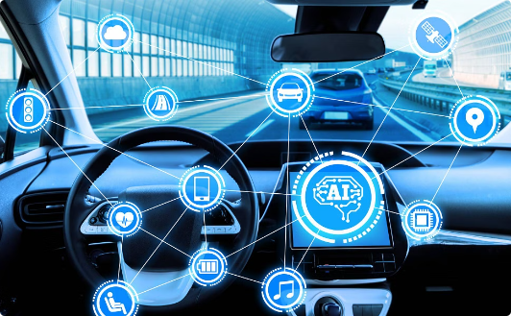

Integration with Vehicle Systems
Navigation
The AI tutor accesses real-time traffic data and navigation information to provide optimal routes and driving instructions.
Entertainment
The AI tutor can control the entertainment system, playing music, podcasts, or audiobooks based on driver preferences and context.
Diagnostics
The AI tutor gathers data from vehicle sensors, such as speed, acceleration, and steering angle, to monitor driving patterns and detect potential risks.

Slide 10


Privacy and Security Considerations
Data Encryption
Sensitive driver data is encrypted to ensure privacy and security during transmission and storage.
User Privacy
Drivers have control over data sharing and can choose to opt-out of certain features that require access to personal information.
Regular Audits
Regular security audits are conducted to identify and address potential vulnerabilities in the system.

Slide 11
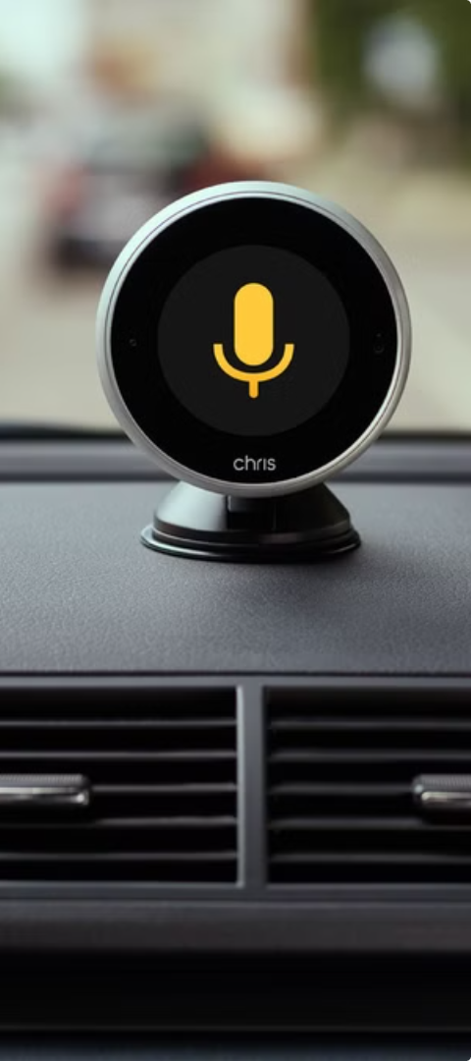
Benefits
1
Enhanced User Experience
2
Improved Safety
AI tutors can monitor driving patterns, identify potential risks, and offer real-time guidance to improve safety.
AI tutors offer a more intuitive and engaging driving experience, providing personalized assistance and learning opportunities.
3
Increased Efficiency
4
Personalized Learning
AI tutors can optimize routes, provide traffic updates, and suggest efficient driving strategies to reduce travel time.
AI tutors continuously learn from driver behavior, adapting their recommendations and assistance to individual needs.

Slide 12

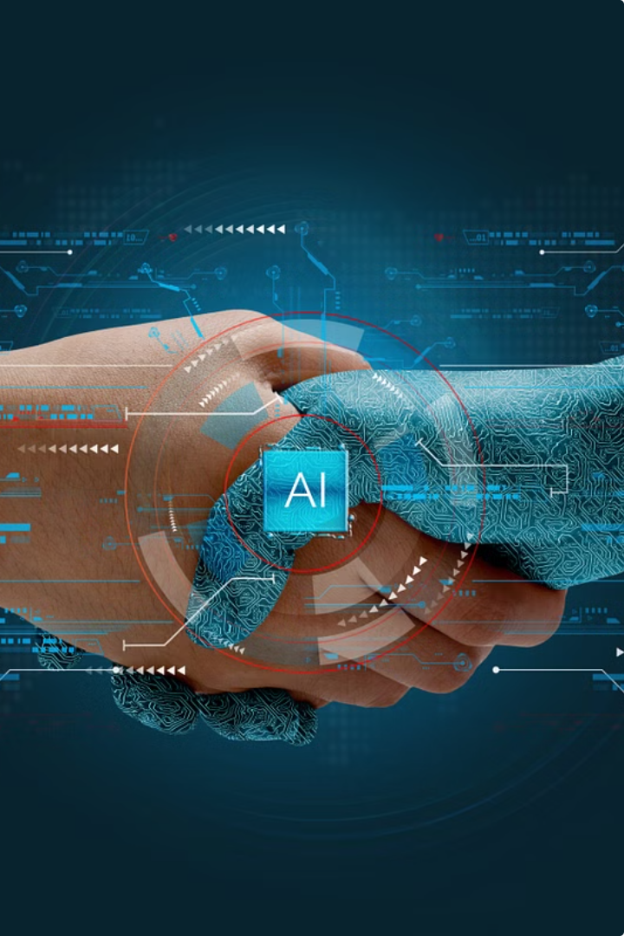


Conclusion and Future Work
Conclusion
AI Tutor aims to revolutionize in-car experience through Generative AI and provide valuable assistance to users with varying levels of car knowledge.
Future Work
Expand AI capabilities to include predictive maintenance and integrate with other smart car systems for a holistic experience.

